Slide 1




SMART WORQ
WORK SMART WITH SMART WORQ
© KELLTON TECH SINGAPORE. ALL RIGHTS RESERVED.

Slide 2
01
02
AGENDA
03
04
The Future of Work
Our Value Proposition
Operations & Pricing
Why Us

Slide 3

THE GREAT ATTRITION

Slide 4
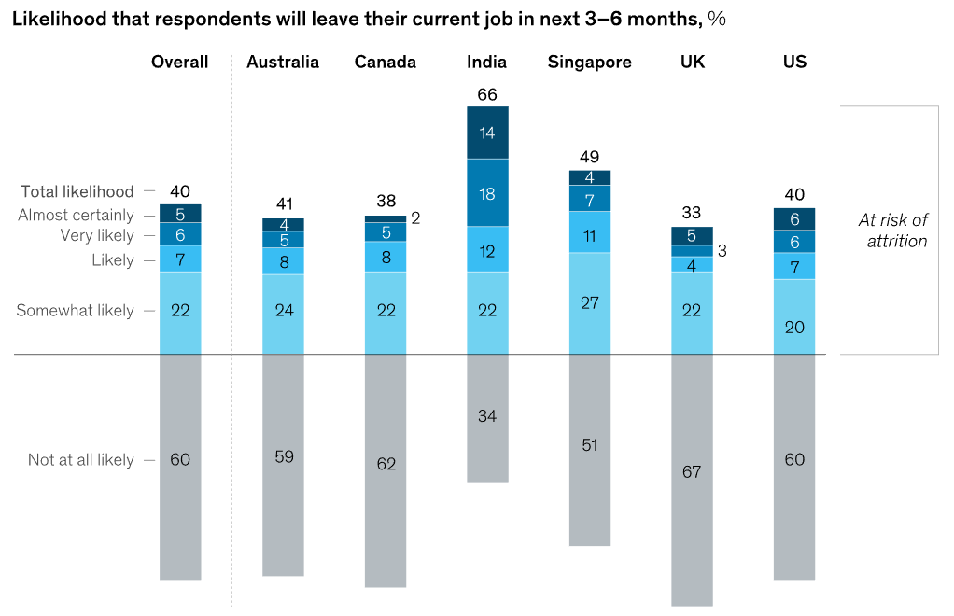
The Great Attrition: In Numbers
“How likely are you to leave your current job in the next 3-6 months?”
Notes:
likelihood that respondents will leave their current job in the next 3-6 months

Slide 5
Globally…
Locally…
40% are likely to leave their jobs in the near future.
This figure is about 50%.

Slide 6

Shopee Employee Reviews
“Turnover rate high, around half of my teammates has left after staying for less than 6 months or before their 3 months probation. The burnout is real.”
“High turnover rate results in no proper SOP throughout, every other month will have a new way of doing things due to change in management.”
“We have at least 50 new hires every WEEK, because turnover rate is ridiculously high.”

Slide 7
What are employees looking for?

Slide 8



What do employees want?
SENSE OF BELONGING
PROFESSIONAL DEVELOPMENT
RECOGNITION
Employees want engagement

Slide 9
Defining Shopee’s Problem Statement

Slide 10


Shopee’s Problem Statement
How can Shopee balance between addressing employees' needs while meeting business objectives?
Engagement
Productivity

Slide 11
Kellton Tech’s Value Proposition
Integrating gamification to work, increasing your employees’ quality of work and quality of life.
SMART WORQ
Work smart with Smart Worq

Slide 12
SMART WORQ
Product Features
Engagement
Productivity
Achievement Badge
Wellness Management
Training and Development
Performance Management

Slide 13
“Everyone wants to be appreciated, so if you appreciate someone, don't keep it a secret.”
Mary Kay Ash
Founder of Mary Kay Cosmetics

Slide 14
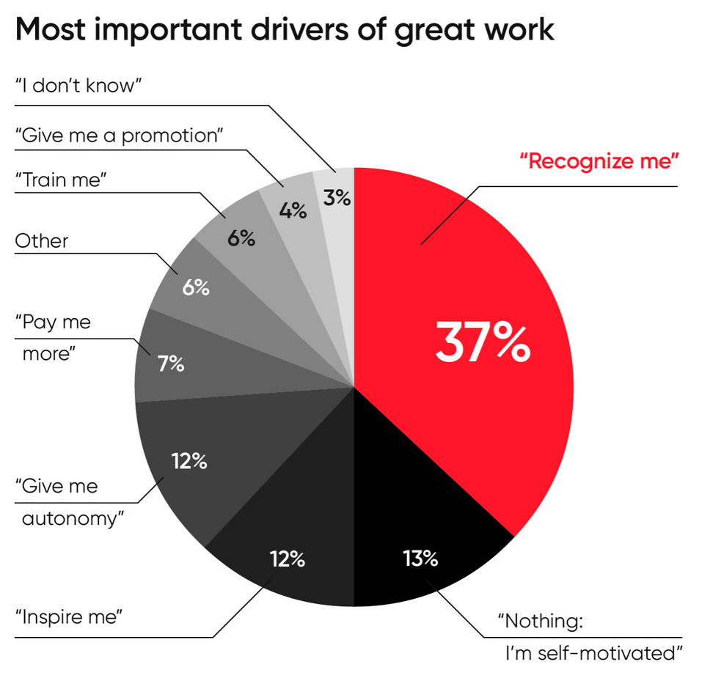
A study from O.C. Tanner found out that
37%
of respondents indicated that receiving more individual praise will motivate them to create better work.

Slide 15
FEATURE #1
CULTURE OF
RECOGNITION
Engagement
Productivity
Engagement
Productivity

Slide 16
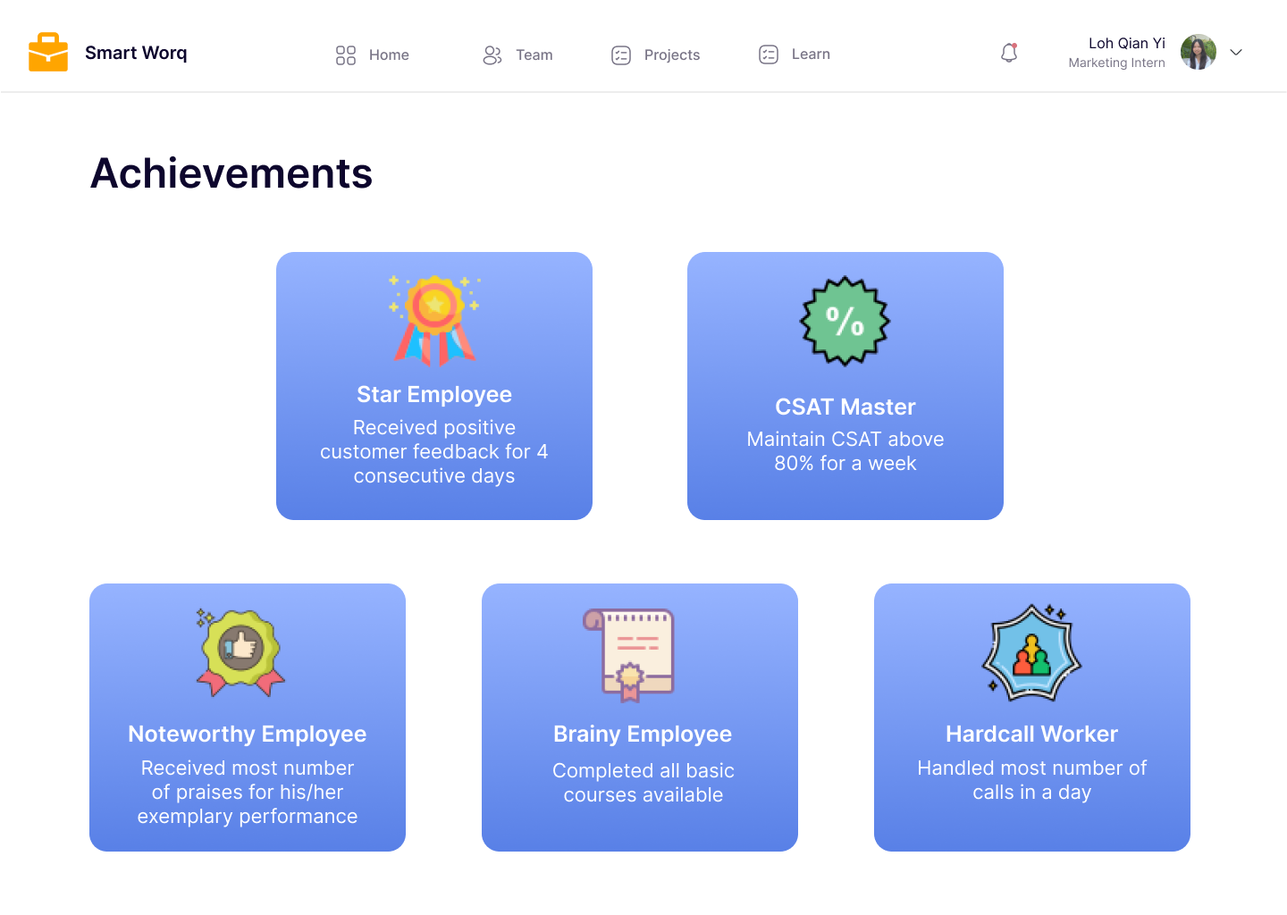
Culture of Recognition
Engagement
Productivity
Engagement
Productivity
Digital badges can be awarded

Slide 17
FEATURE #2
EMPLOYEE WELLNESS MANAGEMENT
Engagement
Productivity
Engagement
Productivity

Slide 18
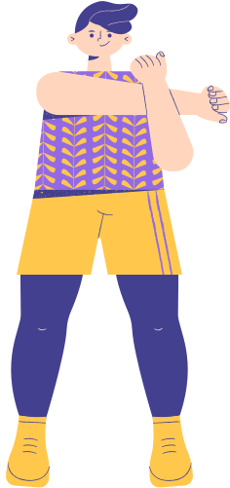
72 %
An article published in the International Journal of Workplace Health Management suggests that EXERCISING leads to
better time management and workload completion on the day.

Slide 19
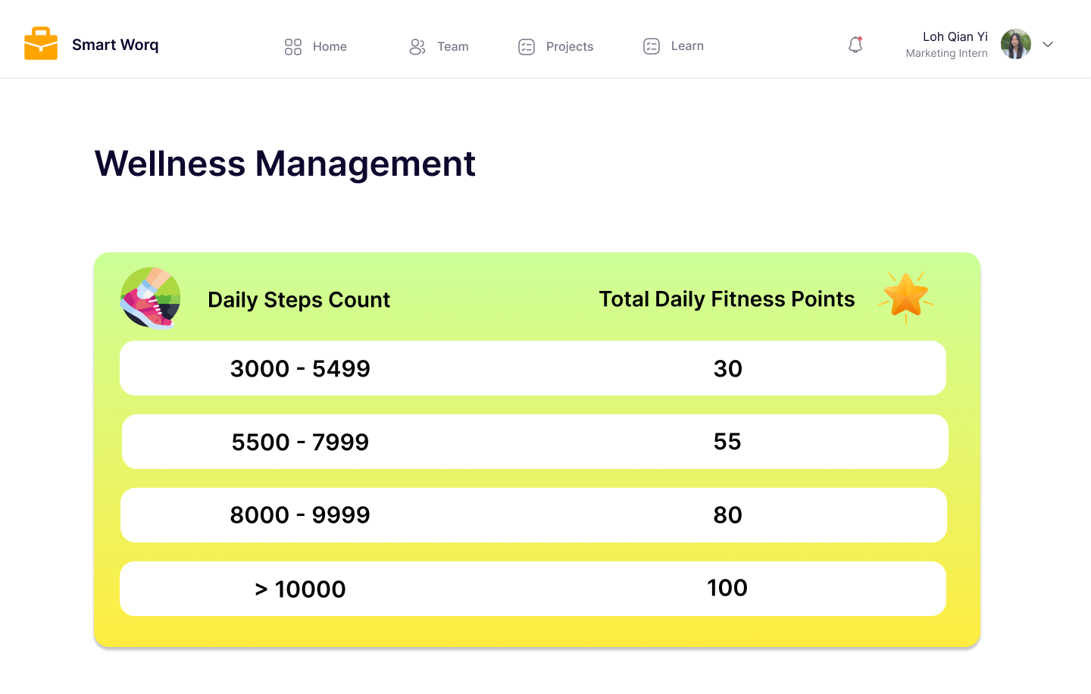

Employee Wellness Management
Engagement
Productivity
Engagement
Productivity
Gamified point system to encourage participation

Slide 20
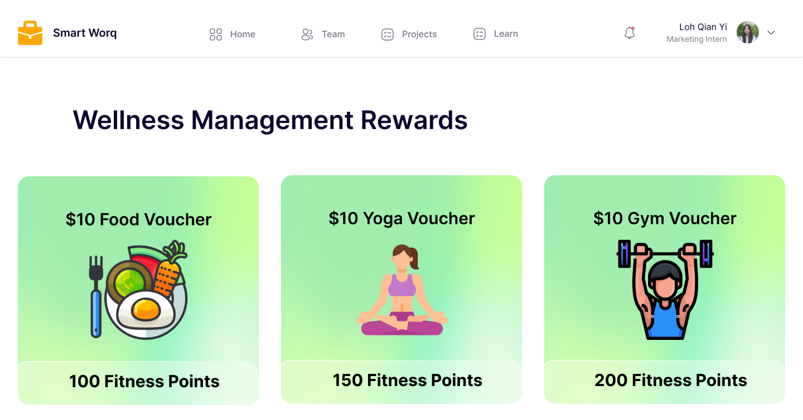
Employee Wellness Management
Engagement
Productivity
Healthy rewards
Fitness points can be exchanged for rewards

Slide 21
FEATURE #3
TRAINING AND DEVELOPMENT
Engagement
Engagement
Engagement
Productivity
Productivity
Productivity

Slide 22
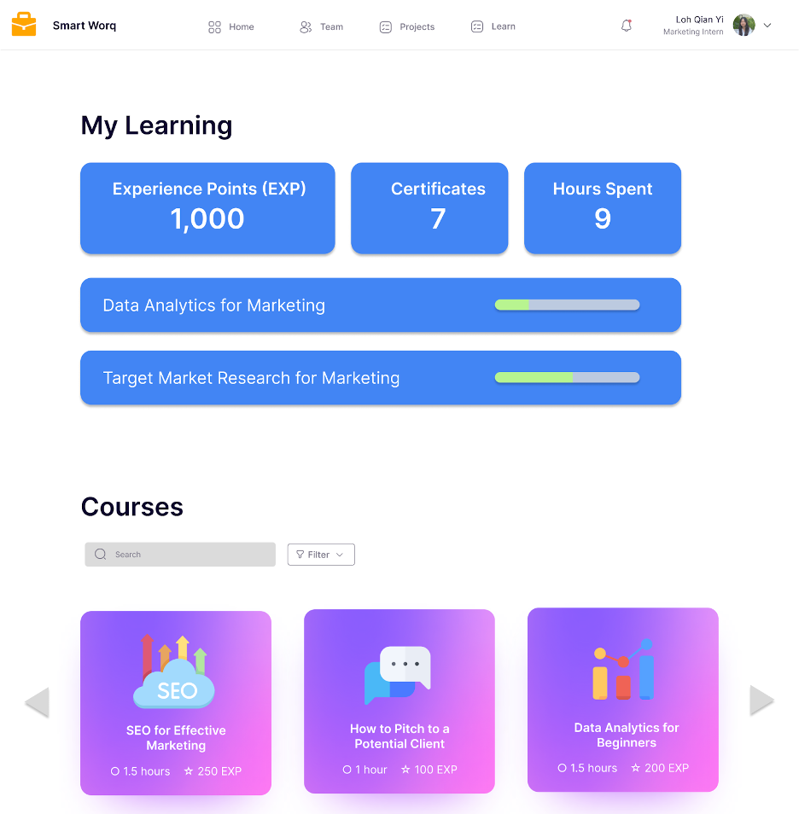
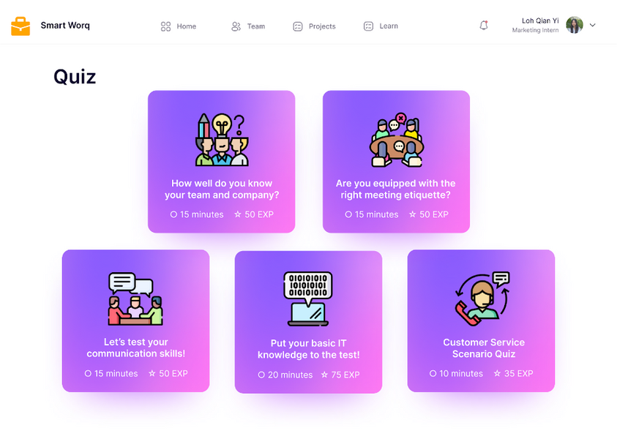
Training and Development
Engagement
Engagement
Engagement
Productivity
Productivity
Productivity
Internal and external courses
Quizzes to strengthen understanding

Slide 23
FEATURE #4
PERFORMANCE MANAGEMENT
Engagement
Engagement
Engagement
Productivity
Productivity
Productivity

Slide 24
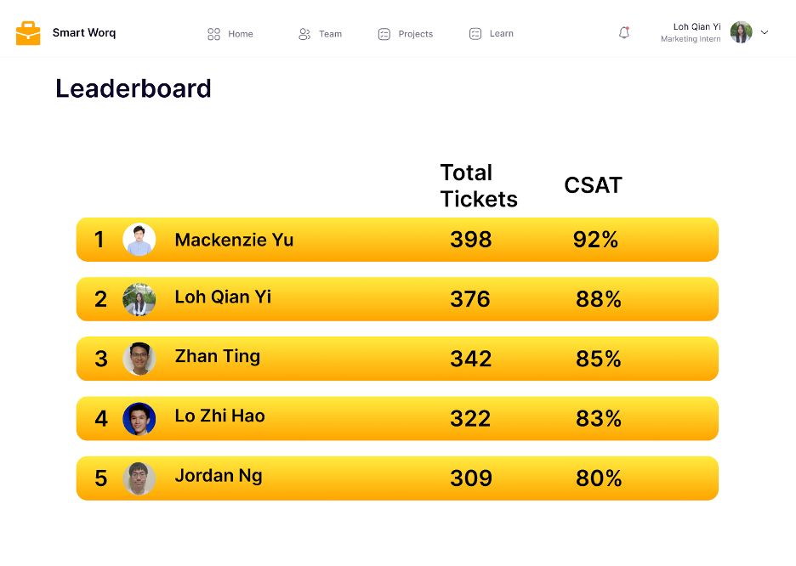

Performance Management
Engagement
Engagement
Engagement
Productivity
Productivity
Productivity
Performance Metrics:
Total Tickets
Customer Satisfaction Score (CSAT)

Slide 25
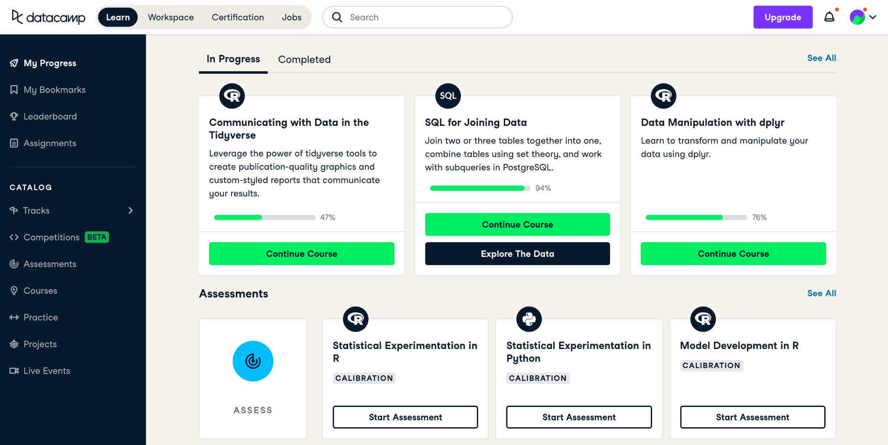

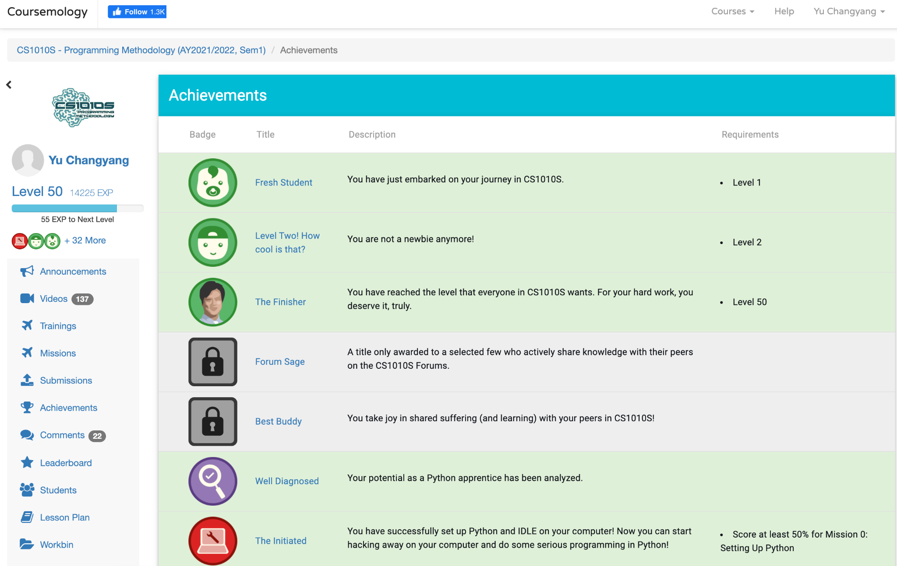

Engagement
Engagement
Productivity
Engagement
Productivity
Productivity

Slide 26
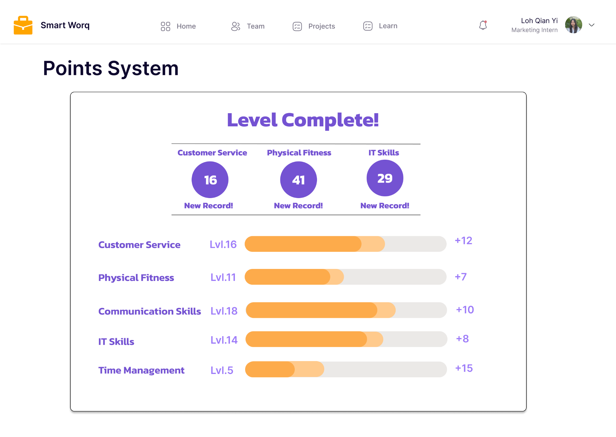
Performance Management
Engagement
Engagement
Productivity
Productivity
Integrated point system (performance of various categories)

Slide 27





Operations
Development Timeline
WEEK 1 - 2
WEEK 3 - 6
WEEK 7 - 14
WEEK 15
WEEK 16 - 20
Planning
Design
Development
Deployment
Support, Maintenance & Update
Business Analytics
User Requirements Gathering
Interface
Experience
Frontend
Backend
Testing
Debugging
Launch
Analyze & Review
Notes:
Thank you Changyang. As Changyang mentioned, I’ll now be explaining the operations and pricing part of the project.
We’ll first take a look at the development timeline of our project which consists of 5 stages.
Firstly, we have (click) the planning stage, followed by (click) Application Design, (click) Application Development, then (click) the Actualizing of the Product, and lastly, (click) the Support, Maintenance & Update of the application once it’s launched.

Slide 28



Operations
Fix unforeseen issues
Boost efficiency
Maintenance Period
Security patching
Adjust to demands
1 Year Timeframe
Conducting Maintenance
Notes:
And you do not have to worry about technical errors, as we have a (click) 1-year maintenance timeframe where we will (click) fix unforeseen issues, (click) boost efficiency, (click) conduct security patching.

Slide 29

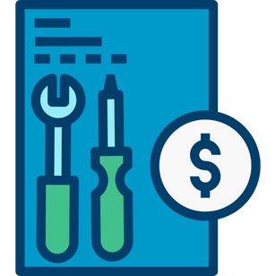

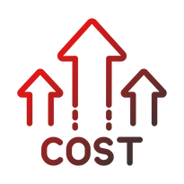
Pricing
SOFTWARE APPLICATION USAGE FEES
SMART WORQ | Market Rate
$40 per user per month (first 3 months) $50 per user per month (rest of tenure) | $50 to $150 per user per month
MAINTENANCE FEES
SMART WORQ | Market Rate
$290 per month | $300 per month onwards
CONSULTANT FEES (ONE-OFF)
SMART WORQ | Market Rate
$123,000 | $125,000 to $5 million
Notes:
Now, what's one thing that clients will definitely take into consideration before investing in a business idea?
That's right! (click) Pricing!
Our pricing is broken down into 3 sections - (click) Software Application Usage Fees, (click) Maintenance Fees, and (click) Consultant Fees
I would like to bring your attention to the words highlighted in red which represent the high market rate price that would mean (click) high costs for Shopee. In comparison, our price is way lower than that.
Yes, you heard that right! Don’t worry, we're not shortchanging you or providing low quality services
We've done thorough research beforehand to come up with this price that is both cost-saving and cost-effective for Shopee, where benefits are sufficiently large compared to the costs.

Slide 30
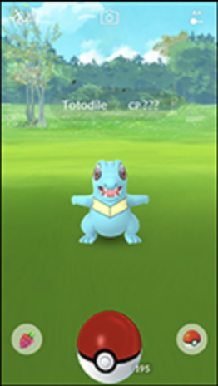
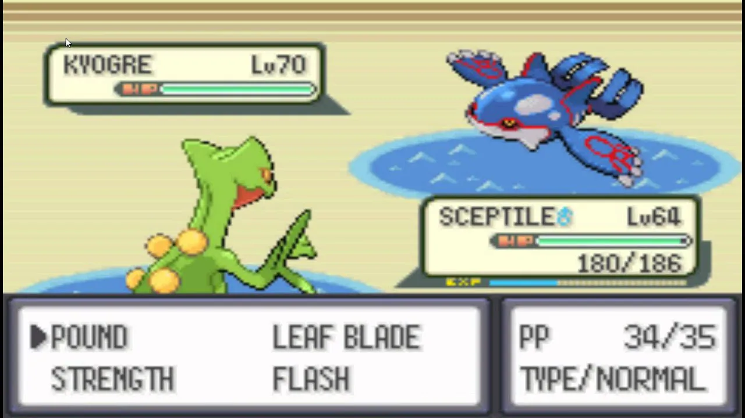
Why
Gamification?

Slide 31



Why Gamification?
Earning gym badges
Leveling up
Learning new skills

Slide 32

Why Gamification?
The compelling motivation to compete, win, level up, and be rewarded ensures the participation of EVERYONE

Slide 33



Employee Level
How can Shopee
benefit
66%
89%
with more employees being happier at work and having lower stress levels
reduces their stress levels
makes them happier at work

Slide 34



Expected Returns
50%
60%
22%
Improved Productivity
Increased Employee
Engagement
Increased
Revenue

Slide 35



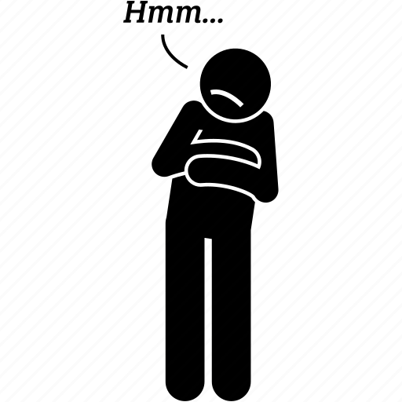
Microsoft
Business challenge
Work overnight
Hesitated
to cooperate

Slide 36


Microsoft
Competitive leaderboard
4x boost

Slide 37

The only way to do great work is to love what you do.
Steve Jobs
Ex-CEO of Apple

Slide 38

Importance of Effective Engagement
Highly engaged employees are 87% less likely to leave their companies than their disengaged counterparts.

Slide 39
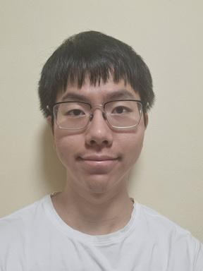
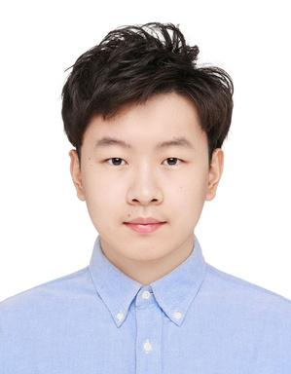

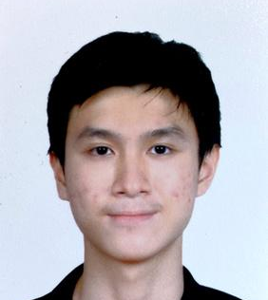
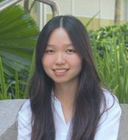
Our Team
Software Development
Human Resource Management
Business
Analytics
JORDAN, NG
CHANGYANG, YU
ZHAN TING, TOH
Senior Software Engineer
Senior Human Resources Manager
Associate Partner
ZHI HAO, LO
QIAN YI, LOH
Engagement Manager
Senior Risk Analyst

Slide 40
SMART WORQ
WORK SMART WITH SMART WORQ
© KELLTON TECH SINGAPORE. ALL RIGHTS RESERVED.

Slide 41
References
Agile CRM pricing. Agile CRM Pricing – Try it for free! (n.d.). Retrieved October 5, 2022, from https://www.agilecrm.com/pricing.
Compare 2022 CRM Costs and Get Quotes | Expert Market. Retrieved October 6, 2022, from https://www.expertmarket.com/crm/compare-pricing#:~:text=CRM%20pricing%3A%20how%20much%20does,%2C%20per%20month%2C%20or%20more.
Consultant Fees. IT Consulting Hourly Rates in 2022 (1 September 2022). Retrieved October 6, 2022, from https://www.cleveroad.com/blog/itconsulting-rates/.
De Smet, A., Dowling, B., Hancock, B., & Schaninger, B. (2022, July 13). The great attrition is making hiring harder. are you searching the right talent pools? McKinsey & Company. Retrieved October 24, 2022, from https://www.mckinsey.com/capabilities/people-and-organizational-performance/our-insights/the-great-attrition-is-making-hiring-harder-are-you-searching-the-right-talent-pools.
https://www.mckinsey.com/capabilities/people-and-organizational-performance/our-insights/great-attrition-or-great-attraction-the-choice-is-yours.
Maintenance Fees. 2022 Website Maintenance Pricing | How much should it cost? (n.d.). Retrieved October 6, 2022, from https://www.webfx.com/webdevelopment/pricing/website-maintenance/.
Manzoor, F., Wei, L., & Asif, M. (1AD, January 1). Intrinsic rewards and employee's performance with the mediating mechanism of employee's motivation. Frontiers. Retrieved October 28, 2022, from https://www.frontiersin.org/articles/10.3389/fpsyg.2021.563070/full
October 15, 2018. (2018, October 14). How exercise improves productivity and your brain function. Burke Britton Financial Partners & Secure Life Financial Solutions. Retrieved October 28, 2022, from https://www.bbfp.com.au/latest-articles/how-exercise-improves-productivity-and-your-brain-function

Slide 42
Q&A Session
Any questions regarding our product?

Slide 43
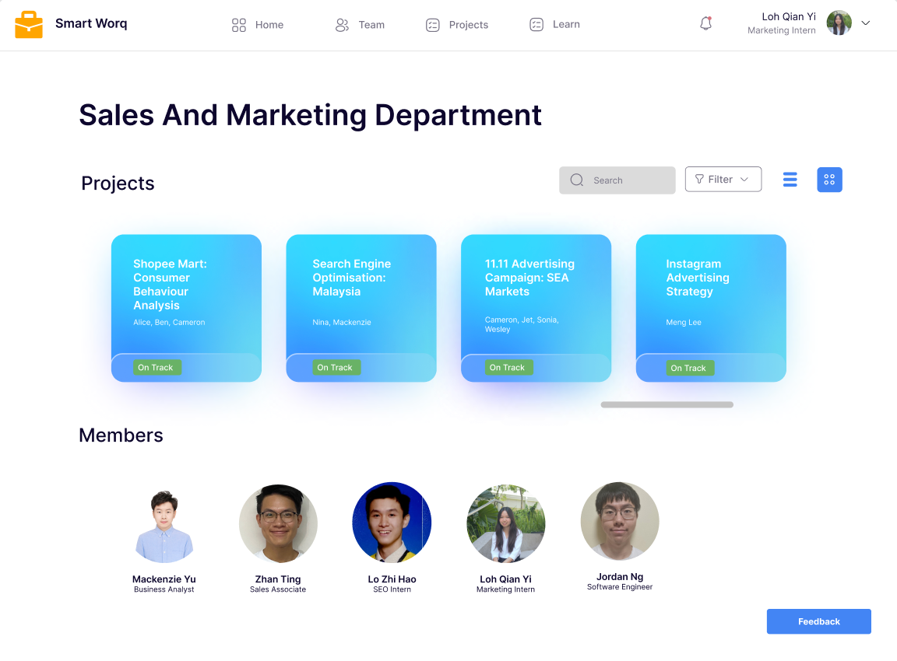

Task Management
Department Overview Page
Projects that the department currently has
Staff under this department

Slide 44
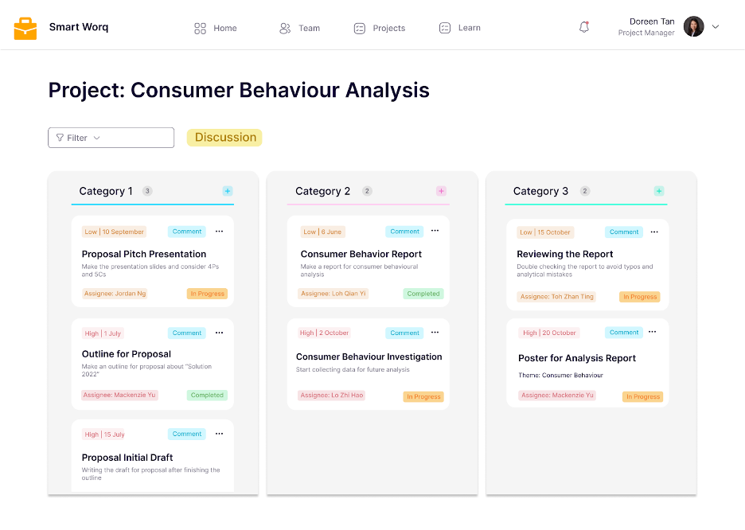


Task Management
Project Page
Sort tasks based on priority, deadline, assignee, etc
For employees to discuss problems

Slide 45



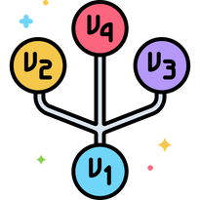




Operations
Logistics
Production
Sales
Communications
Tech Stack
App Store
Internal
Version
Control
Email
External
Launch
Ads
Notes:
Moving on to logistics, we’ll be looking at 3 main components - (click) production, (click) sales and (click) communications
Firstly, for production - the process is as follows, (click) tech stack, followed by (click) version control, and lastly, (click) the launch of the application
Secondly, for sales - we’ll be looking at platforms such as (click) the App store, (click) emails and (click) advertisements to promote our application
Lastly, for communications - channels such as (click) telegram will be used for internal communications and (click) zoom for external communications

Slide 46

Experts report that as much as
70%
of the world’s largest 2000 companies use
Gamification

Slide 47

Summary
Shape their business cultures to adopt higher standards of purpose, relationships, competition, and engagement.
One thing is for certain, overlooking the connectivity gamification can provide employees with their work will no longer be an option.

Slide 48
Feature Comparison
 | SalesScreen | TalentCards | SmartWorq
Deployment | Web-based | Web-based | Mobile,Web-based
Performance Analytics | X | X | Y
Goal Setting/Tracking | Y | X | Y
Training and Development | X | Y | Y
Contest Management | Y | X | Y
Rewards Management | X | Y | Y

Slide 49
Features don’t really incorporate Gamification ?
Gamification is application of game design elements: Points, badges, leaderboard (e.g. Kahoot gives us points, leaderboard)
Our team intentionally to not design our application to be game-like — Employees might get carried away with the game interface rather than focusing on their work

Slide 50
What about employees who lag behind?
Culture of Recognition feature: not only reward top performers, but also has other badges to evaluate an employee (e.g. Badge for completing all basic courses, receiving positive customer feedback)
Performance management feature: related with both employees and employers. Uses of leaderboard not only find employees with professional qualities; also identify the employees with difficulties when doing work
Up to Shopee to create metrics of success (achievement badges / leaderboards), not Kellton Tech.

Slide 51
What are total tickets and CSAT? Why choose these two?
Just an example of the Customer Service Department.
Customer Satisfaction Score (CSAT): asking a simple question such as 'How satisfied were you with your experience?' With corresponding survey scale (1 – 5, or 1 – 10)
Total tickets: when staff receives an incoming call which reports issues and successfully resolves the problems.

Slide 52
Not shortchanging? Then why is price so low?
Kellton Tech has a lot of experience working on this type of project (expertise and tools) — start up cost is very low and hence, the prices can be set lower than the market rate
That’s why you should choose Kellton Tech - we can provide quality service at affordable rate: VALUE FOR MONEY (Best of both world solution - low cost and high returns)

Slide 53
Does it incur more cost on Shopee to provide the rewards listed in the features for Smart Worq?
Shopee already distribute rewards, perks, welfare on a daily basis (e.g. pantry snacks, resting and leisure rooms, vacation); can redistribute these via the platform - no additional cost
Up to Shopee to provide the rewards; Kellton Tech only responsible for providing the interface for the rewards

Slide 54
How to measure employee satisfaction and engagement?
Send out anonymous surveys
Look into retention rate
Survey forum feature — collect data by sending out surveys. After backend data analysis, insights will be sent back to Shopee (report form)

Slide 55
Is the number of weeks allocated to each stage enough?
With ample experience in similar type of projects, the weeks allocated serves as a rough guideline based on our prior experience.

Slide 56
How is the implementation of the courses carried out?
Shopee can decide on what type/kind of courses
Can also liaise and work with external parties/providers to put up courses on the platform.

Slide 57
How about employees who lag behind?
2. What are total tickets and CSAT and why choose these two metrics?
3. Why a lot of features don’t really incorporate gamification?
Culture of Recognition feature: not only reward top performers, but also has other badges to evaluate an employee (e.g. Badge for completing all basic courses, receiving positive customer feedback)
Performance management feature: related with both employees and employers. Uses of leaderboard not only find employees with professional qualities; also identify the employees with difficulties when doing work
Up to Shopee to create metrics of success (achievement badges / leaderboards), not Kellton Tech.
Just an example of the Customer Service Department.
Customer Satisfaction Score (CSAT): asking a simple question such as 'How satisfied were you with your experience?' With corresponding survey scale (1 – 5, or 1 – 10)
Total tickets: when staff receives an incoming call which reports issues and successfully resolves the problems.
Gamification is application of game design elements: Points, badges, leaderboard (e.g. Kahoot gives us points, leaderboard)
Our team intentionally to not design our application to be game-like — Employees might get carried away with the game interface rather than focusing on their work

Slide 58
How about employees who lag behind?
Culture of Recognition feature: not only reward top performers, but also has other badges to evaluate an employee (e.g. Badge for completing all basic courses, receiving positive customer feedback)
Performance management feature: related with both employees and employers. Uses of leaderboard not only find employees with professional qualities; also identify the employees with difficulties when doing work
Up to Shopee to create metrics of success (achievement badges / leaderboards), not Kellton Tech.

Slide 59
What are total tickets and CSAT and why choose these two metrics?
Just an example of the Customer Service Department.
Customer Satisfaction Score (CSAT): asking a simple question such as 'How satisfied were you with your experience?' With corresponding survey scale (1 – 5, or 1 – 10)
Total tickets: when staff receives an incoming call which reports issues and successfully resolves the problems.

Slide 60
Why a lot of features don’t really incorporate gamification?
Gamification is application of game design elements: Points, badges, leaderboard (e.g. Kahoot gives us points, leaderboard)
Our team intentionally to not design our application to be game-like — Employees might get carried away with the game interface rather than focusing on their work

Slide 61
THE SLIDE TITLE GOES HERE!
Do you know what helps you make your point clear? Lists like this one:
● They’re simple
● You can organize your ideas clearly
● You’ll never forget to buy milk!
And the most important thing: the audience won’t miss the point of your
presentation

Slide 62
YOU COULD USE THREE COLUMNS, WHY NOT?
MAYBE YOU NEED TO DIVIDE THE CONTENT
MARS
JUPITER
MERCURY
Despite being red, Mars is a cold place
It’s a gas giant and also the biggest planet
Mercury is the closest planet to the Sun

Slide 63

A PICTURE ALWAYS REINFORCES THE CONCEPT
Images reveal large amounts of data, so remember: use an image instead of a long text

Slide 64

A PICTURE IS WORTH A
THOUSAND WORDS

Slide 65
AWESOME
WORDS
Because key words are great for
catching your audience’s attention

Slide 66
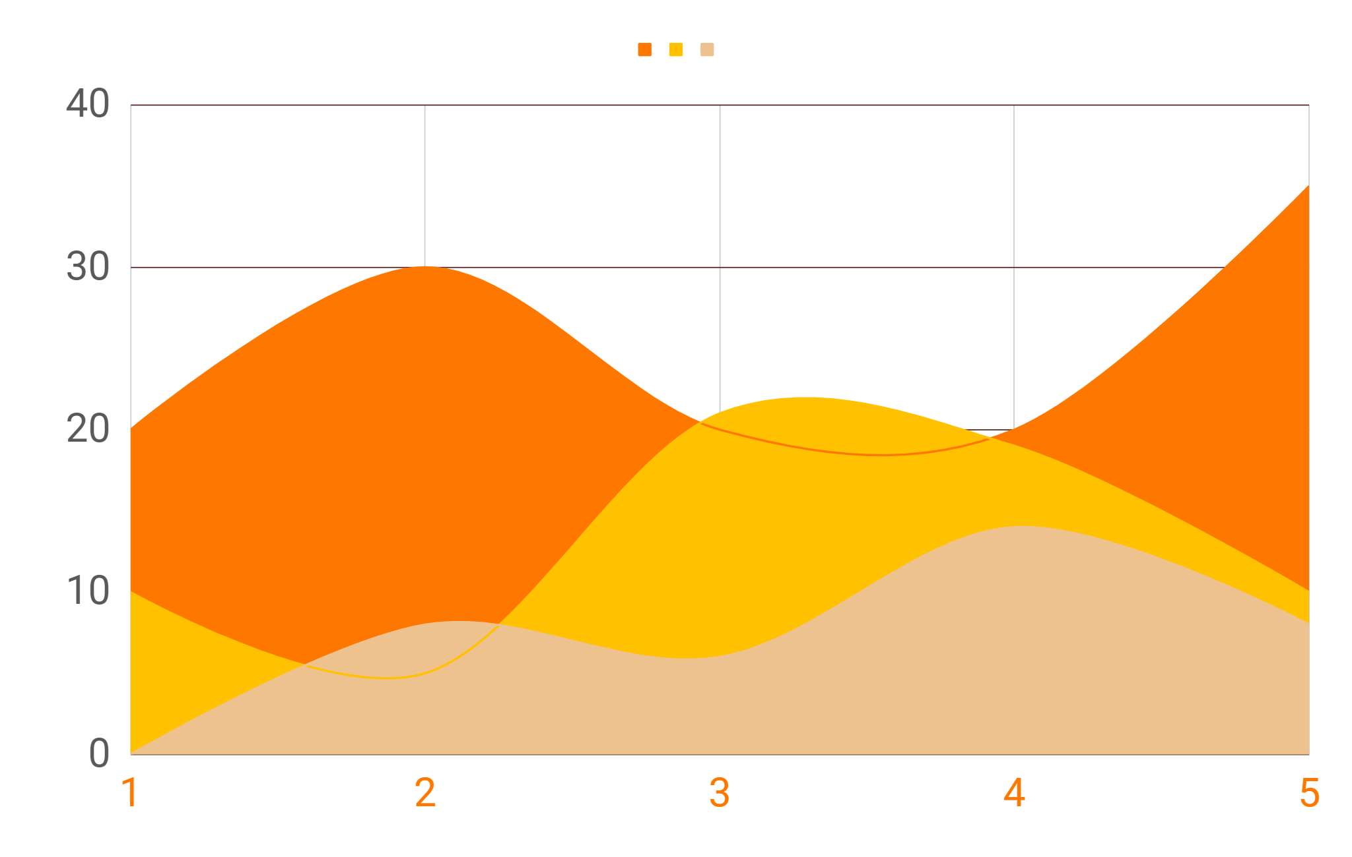
TRY USING GRAPHS!
MARS
Despite being red, it is cold
VENUS
Venus has a beautiful name
MERCURY
It is the smallest planet
To modify this graph, click on it, follow the link, change the data and paste the new graph here

Slide 67
FEATURES OF THE TOPIC
MERCURY
VENUS
MARS
JUPITER
SATURN
NEPTUNE
Mercury is the closest planet to the Sun
Venus has a beautiful name
Despite being red, Mars is a cold place
It’s the biggest planet in the Solar System
Saturn is the ringed one and a gas giant
Neptune is the farthest planet from the Sun

Slide 68
WHAT ABOUT THESE PERCENTAGES?
MERCURY
NEPTUNE
MARS
Mercury is the smallest planet
It’s the farthest planet from the Sun
100%
50%
25%
Despite being red, Mars is a cold place

Slide 69
INFOGRAPHICS MAKE YOUR IDEA
UNDERSTANDABLE...
MARS
MERCURY
JUPITER
VENUS
Despite being red, Mars is a cold place.
Mercury is the closest planet to the Sun
It’s a gas giant and also the biggest planet
Venus has a beautiful name

Slide 70
...AND THE SAME GOES FOR TABLES
 | MASS (earths) | DIAMETER (earths) | SURFACE GRAVITY (earths)
MERCURY | 0.06 | 0.38 | 0.38
MARS | 0.11 | 0.53 | 0.38
SATURN | 95.2 | 9.4 | 1.16

Slide 71
A TIMELINE ALWAYS WORKS WELL
MARS
MERCURY
JUPITER
VENUS
01
03
02
04
Despite being red, Mars is a cold place
Mercury is the closest planet to the Sun
It’s a gas giant and also the biggest planet
Venus is the second planet from the Sun

Slide 72
4,498,300
Big numbers catch your audience’s attention

Slide 73


OUR TEAM
HELENA JAMES
JENNA DOE
You can replace the image on the screen with your own
You can replace the image on the screen with your own

Slide 74
333,000.00
24h 37m 23s
386,000 km
earths is the Sun’s mass
is Jupiter’s rotation period
is the distance between Earth and the Moon

Slide 75
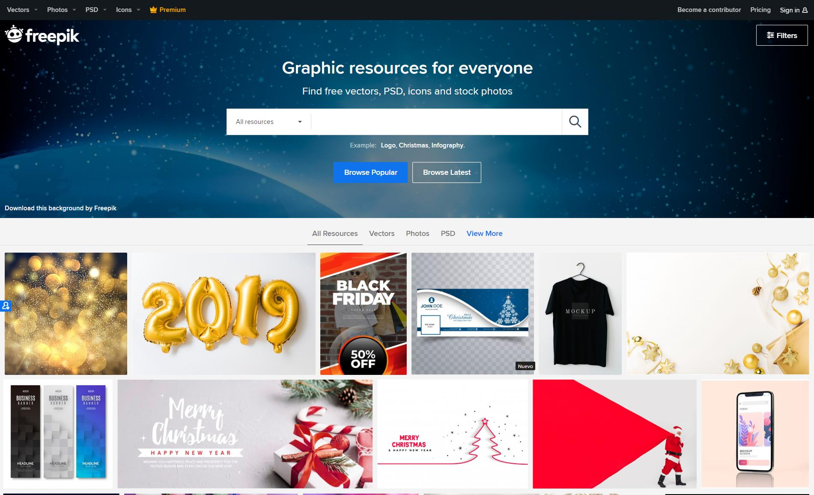
DESKTOP SOFTWARE
You can replace the image on the screen with your own work. Just delete this one, add yours and center it properly

Slide 76
INFOGRAPHICS MAKE YOUR
IDEA UNDERSTANDABLE…
Mercury is the smallest planet in the Solar System
Venus is terribly hot and its atmosphere is extremely poisonous
Despite being red, Mars is actually a cold place
It’s a gas giant and the biggest planet in the Solar System

Slide 77
YOU CAN TRY THESE INFOGRAPHICS!
MARS
MERCURY
JUPITER
VENUS
Despite being red, Mars is a cold place
Mercury is the closest planet to the Sun
Venus has a beautiful name, but it’s terribly hot
It’s a gas giant and also the biggest planet

Slide 78
02
THE COMPANY
You can enter a subtitle here if you need it

Slide 79
SOMETIMES, REVIEWING
CONCEPTS IS A GOOD IDEA
MERCURY
MARS
VENUS
SATURN
JUPITER
EARTH
Mercury is the smallest planet
Despite being red, Mars is a cold place
Venus has a beautiful name
Saturn is a gas giant and has rings
It’s a gas giant and the biggest planet
Earth is the third planet from the Sun

Slide 80
ANOTHER TIMELINE!
MARS
VENUS
JUPITER
SATURN
Despite being red, Mars is a cold place
Venus is the second planet from the Sun
It’s a gas giant and also the biggest planet
Saturn is a gas giant and has several rings

Slide 81
THANKS!
Do you have any questions?
addyouremail@freepik.com
+91 620 421 838
yourcompany.com
Please keep this slide for attribution

